Slide 1
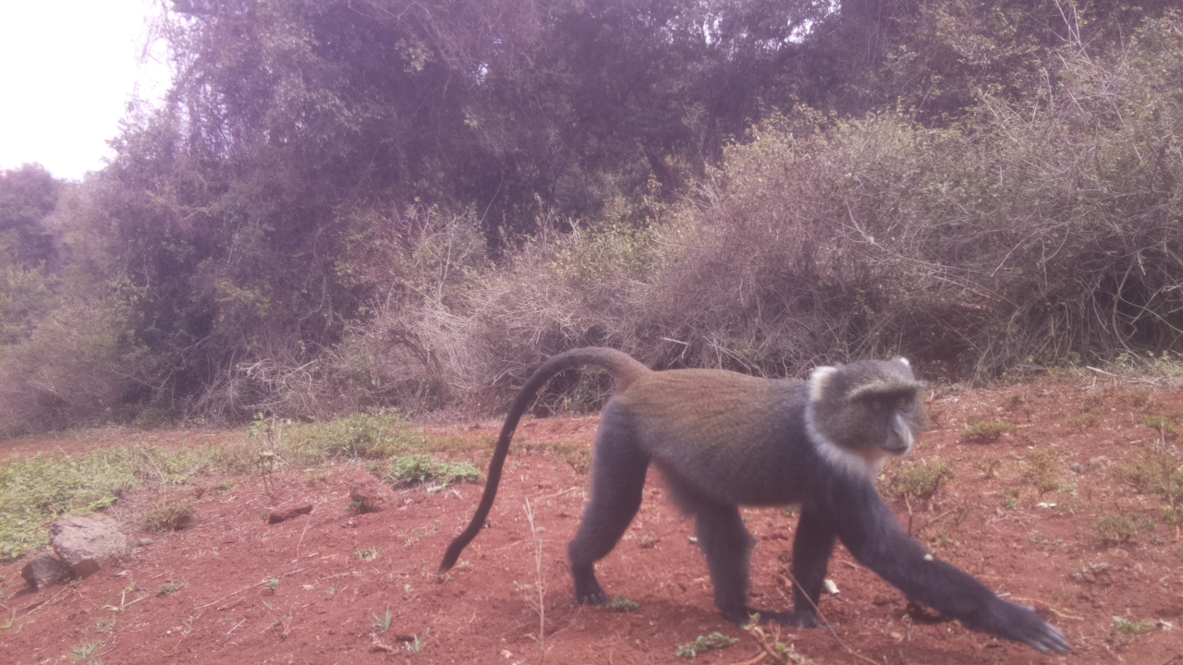
DSAIL-Porini: Annotated camera trap images of wildlife species from a conservancy in Kenya
Lorna Mugambi & David Yuri Njathi
Centre for Data Science and Artificial Intelligence (DSAIL)

Slide 2
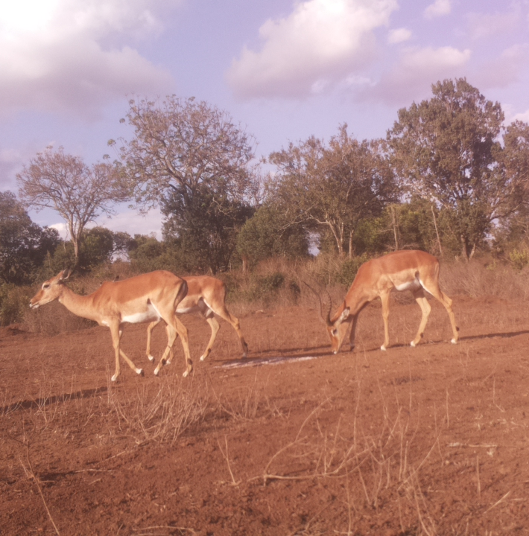
Introduction
Camera traps record accurate data in a non-invasive way
These data can be reviewed/used by other researchers.
Replaced traditional techniques
Deployed 4 camera traps for 7 months.

Slide 3
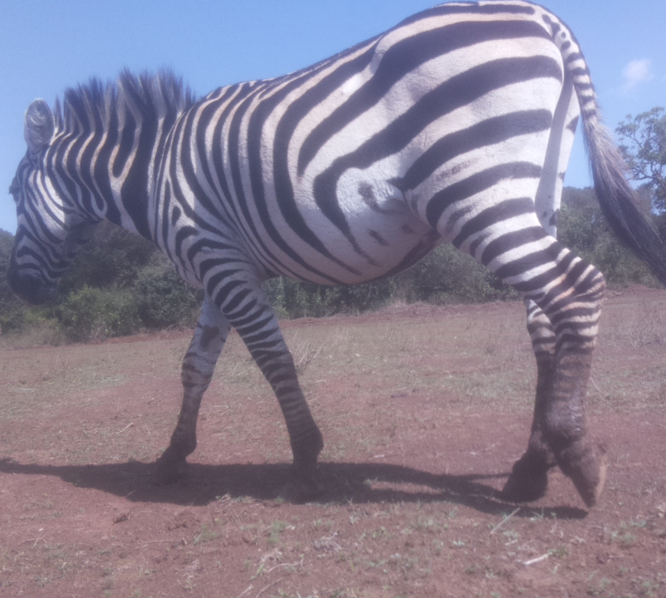
DSAIL-Porini Dataset
8524 annotated images of animals;
The dataset has 6 categories;
Impalas,
Warthogs,
Zebras,
Monkeys,
Waterbucks
Bushbucks.

Slide 4
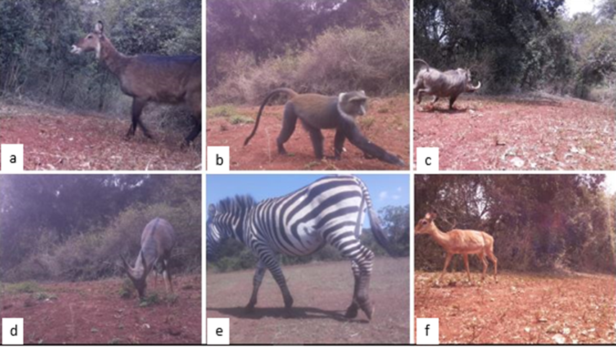
Species in the conservancy

Slide 5
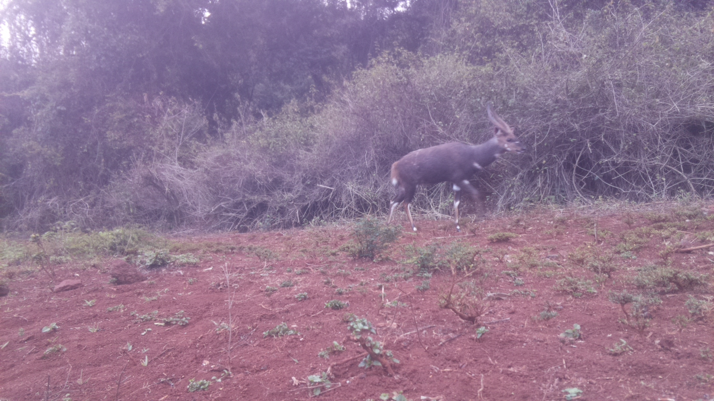
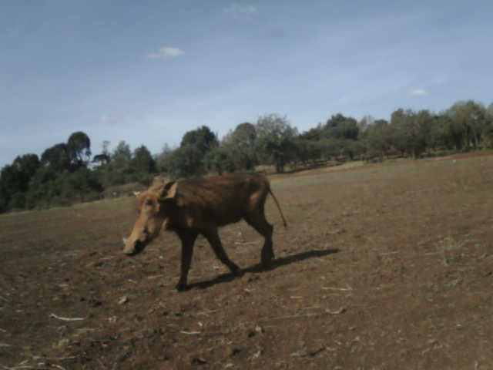
Value of the Data
Train machine learning models to classify and segment images of animals.
Test image based censusing algorithms as it includes animal counts.
Understand animal behaviour
Estimate the size of the animal population with time

Slide 6
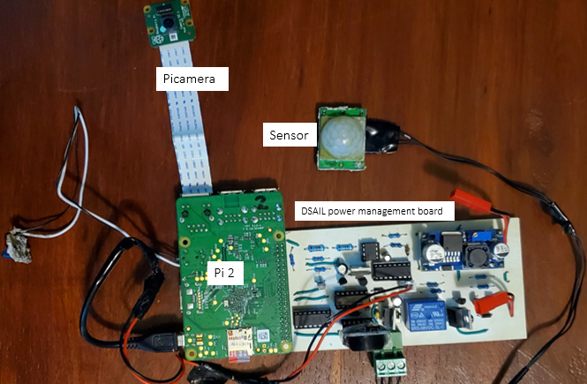
Hardware & Software
Based on Raspberry Pi 2, Pi-zero and the Open Mv Cam.
All programs written using python
PIR sensor
SD (saving format: YYYY-MM-DD-H-M-S)

Slide 7
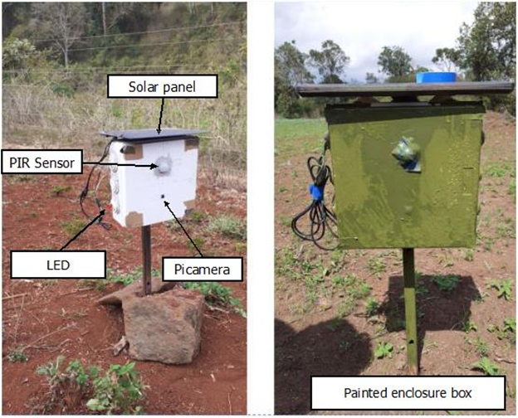
Deployment
Camouflage
Advantage: more close up images

Slide 8
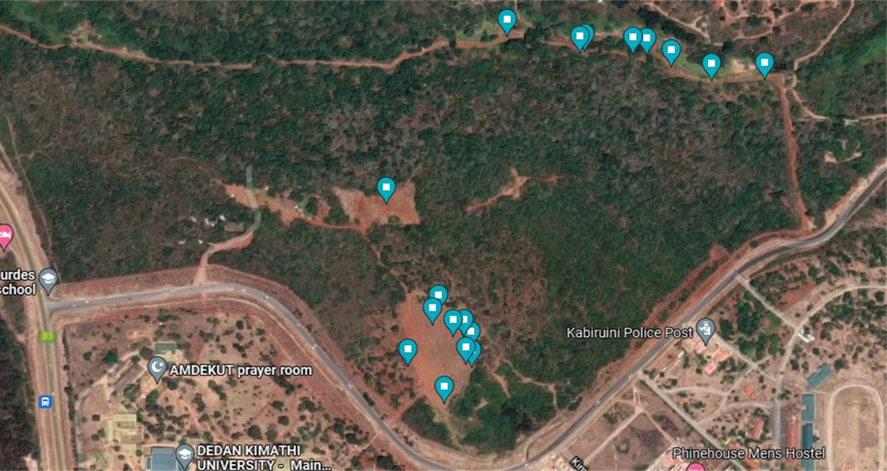
Camera trap placement

Slide 9
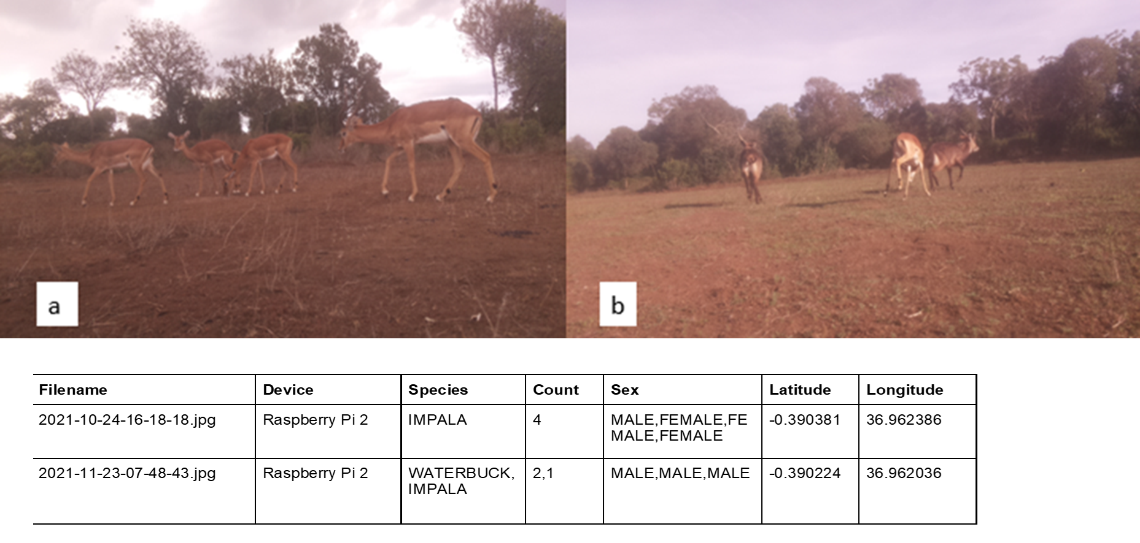
Data Annotation

Slide 10
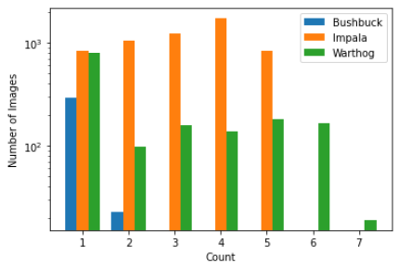
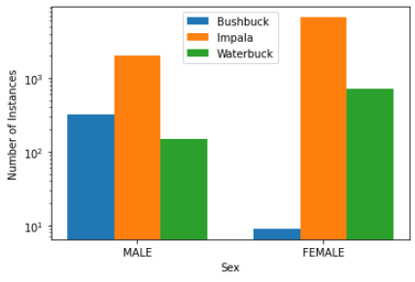
Data analysis
Count distribution
Sex distribution

Slide 11
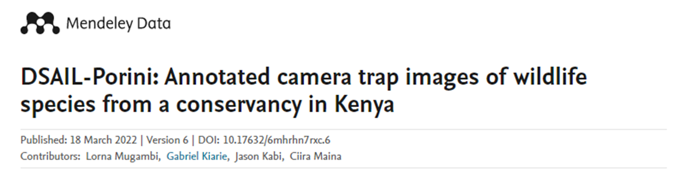
Publications
L. Mugambi, J. Kabi, G. Kiarie and C. wa Maina, “DSAIL-Porini: Annotated camera trap images of wildlife species from a conservancy in Kenya," Submitted, 2022.

Slide 12
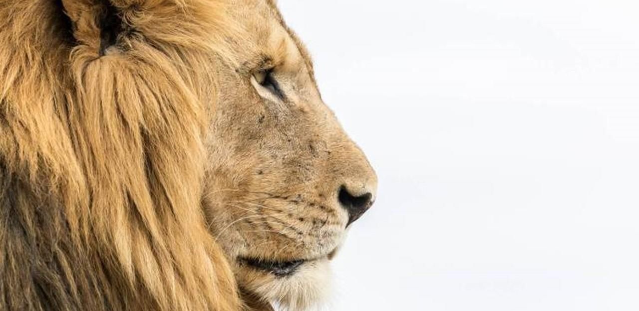

The way to get started is to quit talking and begin doing.
Walt Disney
Lorna Mugambi lorna.mugambi@dkut.ac.ke
David Yuri Njathi yurinjathi@gmail.com

